Slide 1
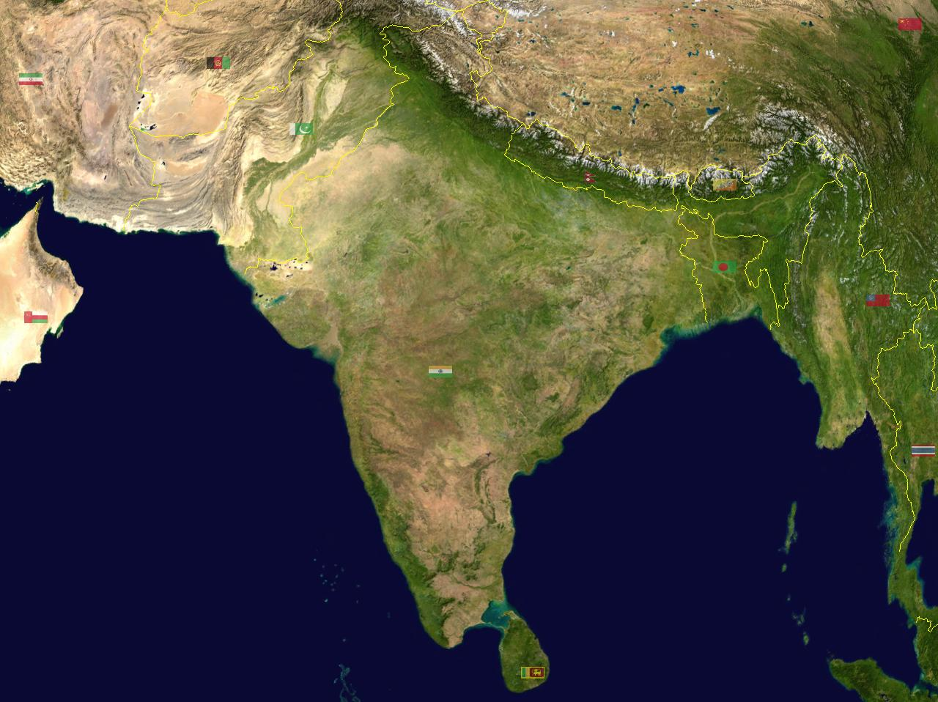
INDIAN KNOWLEDGE SYSTEM

Slide 2
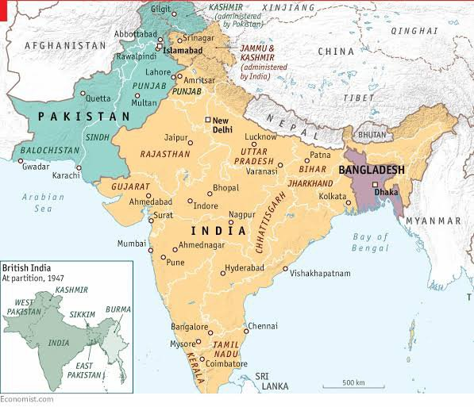
भारतभूमि

Slide 3
“Bharatbhumi”
"Bharatbhumi" is a term that combines "Bharat" (an ancient name for India) and "bhumi" (meaning land or earth). It refers to the land of Bharat, symbolizing India. The term is often used to evoke a sense of national pride, heritage, and connection to the historical and cultural roots of the Indian subcontinent.
"Bhārata" gained popularity in India during the nineteenth century. It is the shortened form of the term "Bhāratavarṣa" which was first used in the first century AD in the Puranas. "Bhāratavarṣa" is derived from the name of the Vedic community of Bharatas who are mentioned in the Rigveda as one of the principal kingdoms of the Aryavarta. It is also variously said to be derived from the name of either Dushyanta's son Bharata or Mahabharata. At first the name Bhāratavarṣa referred only to the western part of the Gangetic Valley, but was later more broadly applied to the Indian subcontinent and the region of Greater India.

Slide 4
Bharatbhumi
"Bharatbhumi," or the land of Bharat (India), is characterized by several distinctive features:
1.Cultural Diversity: India is renowned for its rich tapestry of languages, religions, traditions, and festivals, reflecting its diverse cultural heritage.
2. Historical Legacy: The region boasts a long and complex history, with ancient civilizations like the Indus Valley Civilization, and significant historical periods such as the Maurya, Gupta, Mughal, and British empires.
3. Geographical Diversity: Bharatbhumi encompasses a variety of landscapes, from the towering Himalayas in the north to the coastal plains in the south, and from the arid deserts of the west to the lush rainforests in the northeast.
4. Religious Significance: It is the birthplace of major religions like Hinduism, Buddhism, Jainism, and Sikhism, and is home to a multitude of other religious communities, including Islam and Christianity.

Slide 5
Bharatbhummi
5. Economic Variedness: The economy of Bharatbhumi is diverse, with a mix of agriculture, industry, and services sectors. It includes both highly developed urban areas and rural regions.
6. Political Structure: India is a federal parliamentary democratic republic, with a complex political structure that includes central and state governments.
7. Natural Resources: The country is rich in natural resources, including minerals, forests, and water bodies, which support various industries and agriculture.
8. Spiritual Heritage: The land is also known for its spiritual practices and philosophical traditions, influencing both local and global thought.

Slide 6
Saraswati River
The Saraswati River is a significant river in ancient Indian texts and mythology, often mentioned in the Vedas and other ancient scriptures. It is believed to have been a major river in the northwestern part of the Indian subcontinent, flowing through what is now modern-day India and Pakistan.

Slide 7
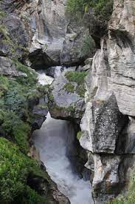
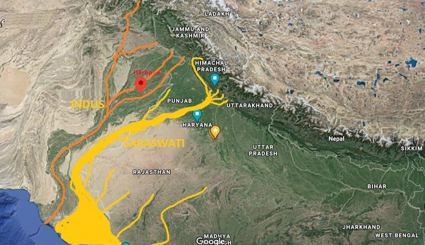
Saraswati River

Slide 8
Saraswati River
1. Historical and Mythological Importance: In Hindu mythology, the Saraswati River is personified as a goddess of wisdom, learning, and arts. The river is considered sacred, and numerous hymns and prayers are dedicated to it in the Vedas.
2. Geographical Context: Historically, the Saraswati River is described as originating from the Himalayas and flowing through the regions of present-day Haryana and Punjab before eventually merging into the Arabian Sea. However, its exact course is a subject of historical and archaeological debate.

Slide 9
Saraswati River
3.Rivers and Civilizations: The Saraswati River is often associated with the Indus Valley Civilization, with some theories suggesting that it played a crucial role in the life and culture of this ancient civilization. It is mentioned alongside other major rivers such as the Indus and the Ganges in ancient texts.
4. Current Status: The river is largely considered to be a mythical or lost river in modern times, with no clear physical evidence of its existence in the present geographical landscape. Some theories suggest that it may have dried up or changed course over millennia.
5. Archaeological Interest: Various archaeological surveys and studies have sought to trace the ancient course of the Saraswati River, often through the examination of ancient riverbed deposits and other geological evidence.

Slide 10
The disappearance of the Saraswati River
1.Tectonic Activity: Shifts in tectonic plates could have altered the river’s course or caused it to change its flow. The region where the Saraswati River was believed to flow is seismically active, and tectonic movements could have led to the river's diversion or disappearance.
2. Climate Change: Changes in climate over millennia could have led to significant alterations in the river's flow. The region might have experienced periods of drought or shifts in precipitation patterns that reduced the river's water flow or caused it to dry up.
3. Sedimentation: Over time, sediment carried by the river could have accumulated, blocking its flow and causing the river to change course or eventually disappear. Sedimentation could have filled the riverbed, leading to the river being buried under layers of silt and debris.4

Slide 11
Continued…
4. Glacial Melting and Shifts: The Saraswati River is believed to have had its origins in the Himalayas. Changes in glacial melt patterns and the retreat of glaciers could have impacted the river’s flow, potentially reducing its volume or altering its course.
5. River Capture: The river might have been captured by neighboring river systems. This occurs when a river erodes a path into another river's basin, diverting its flow away from its original course.
6. Human Activity: Although less documented for ancient times, human activities such as irrigation and deforestation could have impacted river systems, potentially contributing to the river’s decline.

Slide 12
Indus Valley Civilization
1. Geographical Extent: The civilization spanned over 1.25 million square kilometers, with major urban centers including Harappa and Mohenjo-Daro. Other notable sites include Dholavira, Lothal, and Kalibangan.
2. Urban Planning: The Indus Valley cities were known for their advanced urban planning. They had well-organized street grids, sophisticated drainage systems, and standardized fired-brick buildings.
3. Architecture: Buildings included residential homes, public baths (such as the Great Bath of Mohenjo-Daro), granaries, and warehouses. The use of uniform brick sizes indicates a level of standardization in construction.
4. Economy: The economy was primarily based on agriculture, with evidence of irrigation systems to support farming. The civilization also engaged in trade, both internal and with distant regions like Mesopotamia. Artifacts suggest that they traded goods such as beads, metals, and textiles.5.

Slide 13
Indus Valley Civilization
5. Writing System: The Indus Valley Civilization had a script that remains undeciphered. It consists of a series of seals and inscriptions found at various sites, which suggests a form of writing used for administrative or commercial purposes.
6. Social Organization: While the exact social structure is not fully understood, evidence suggests a relatively uniform society with a focus on communal planning and organization. There is little evidence of monumental religious structures, which has led some scholars to speculate about the nature of their religious practices.
7. Art and Craftsmanship: The civilization is known for its intricate beadwork, pottery, and terracotta figurines. Artifacts such as the dancing girl statue from Mohenjo-Daro showcase their skill in artistry.
8. Decline: The reasons for the decline of the Indus Valley Civilization around 1900 BCE are not entirely clear. Theories include environmental changes (such as shifting river courses and climatic changes), overuse of resources, and possibly invasions or conflicts.

Slide 14
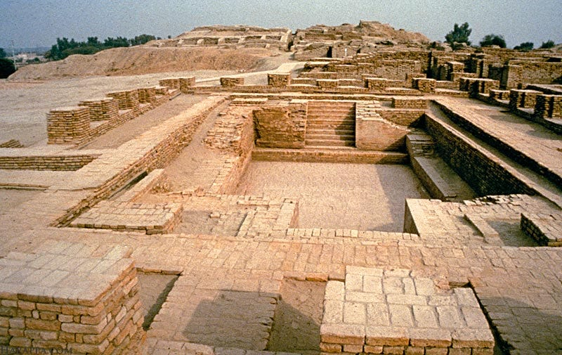
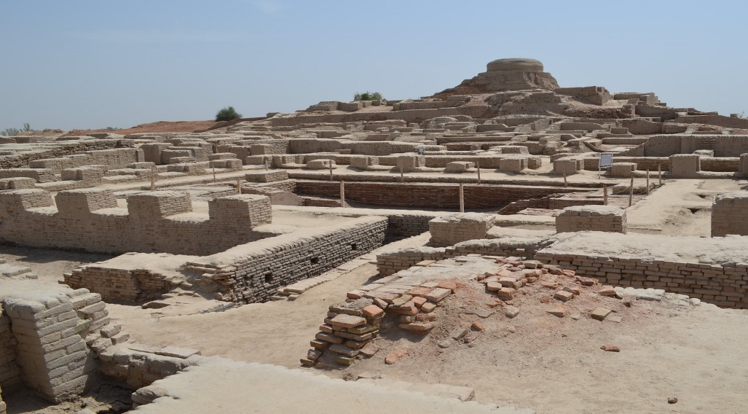
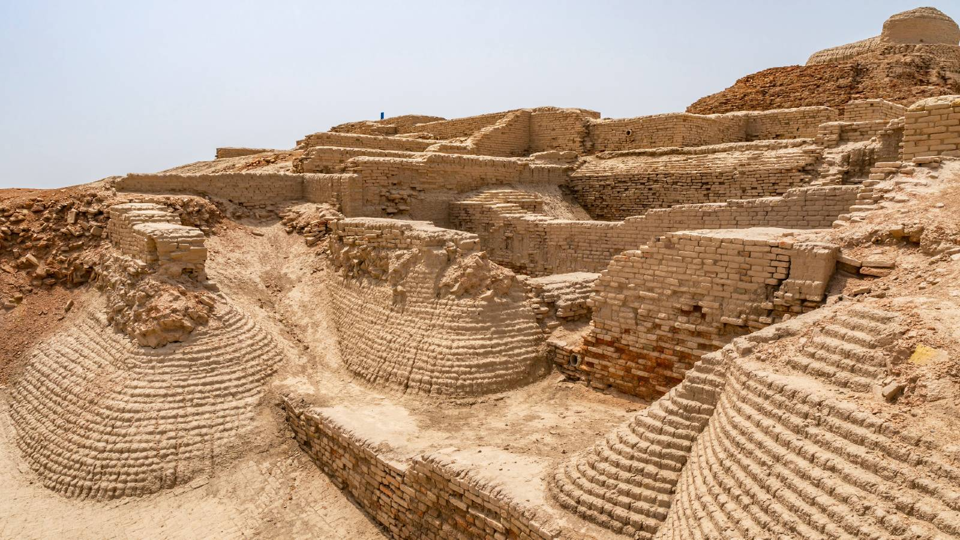
Harappa, Mohenjo-Daro in Pakistan

Slide 15
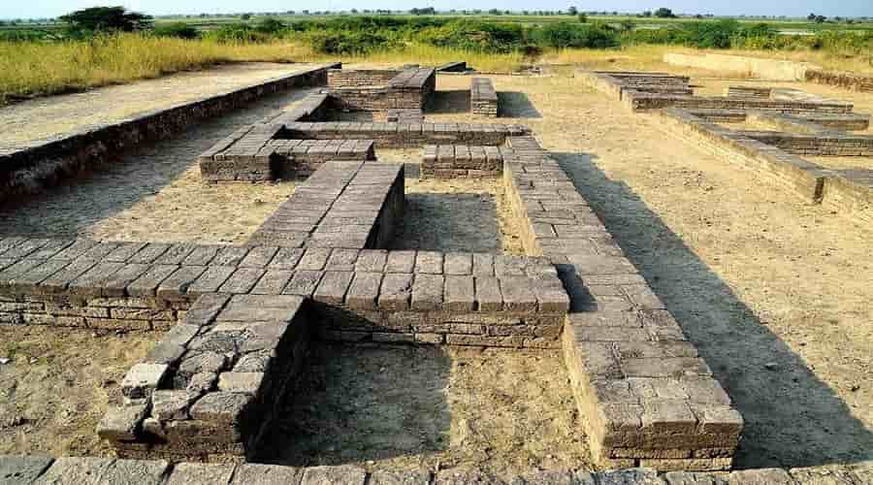
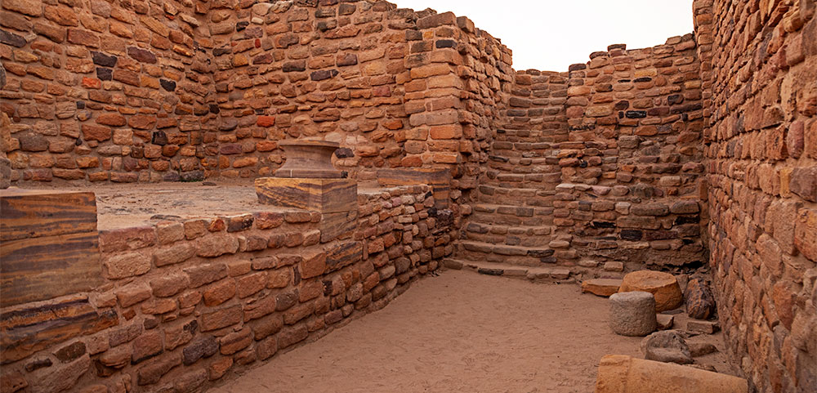
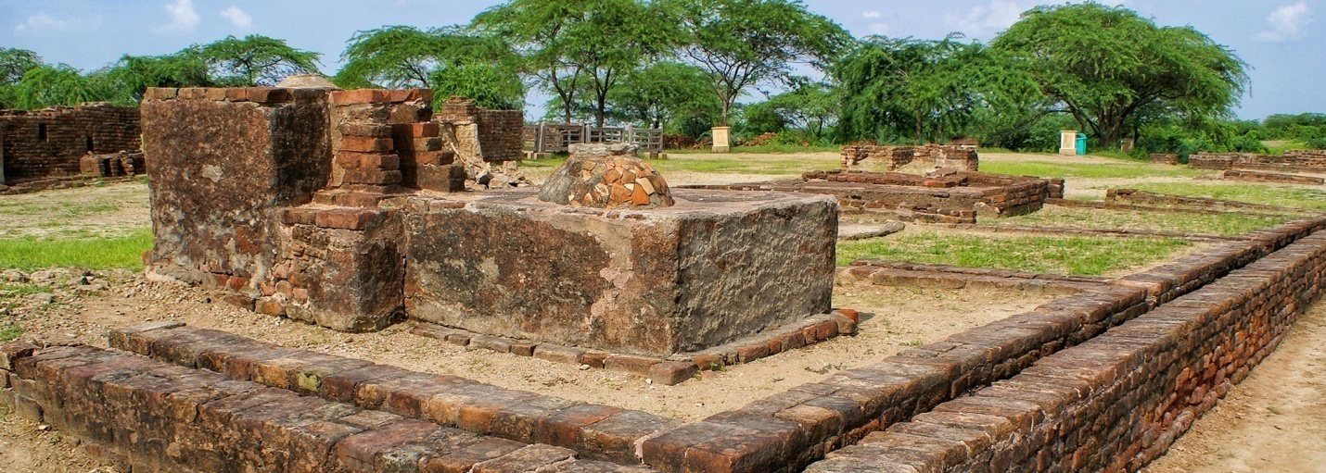
Lothal, Dhaulavira in India

Slide 16
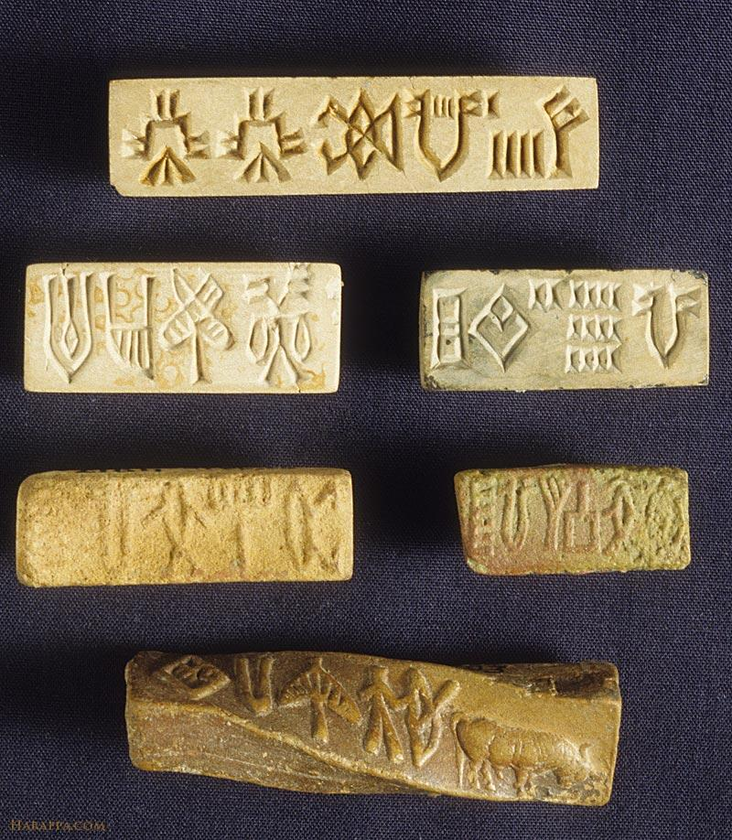
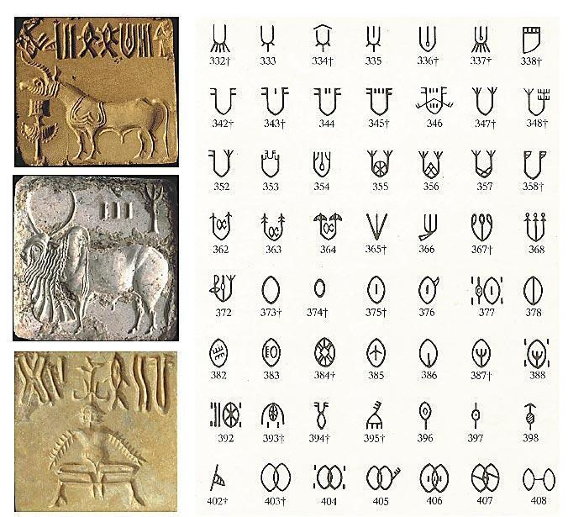
Script

